Slide 1
WEL COME

Slide 2
Teacher’s Identity
Md. Eusuf Ali M A M Ed.
Assistant Teacher
Bakrikandi Adarsha High School
Debidwar- Comilla
Mobile No. 01944689392

Slide 3
Introduction to the lesson
Grade -8
Subject: English-1st paper
Unit-7,(Different people, Different occupation)
Lessons: 3
Time: 45 minutes
Date:21/08/2015

Slide 4
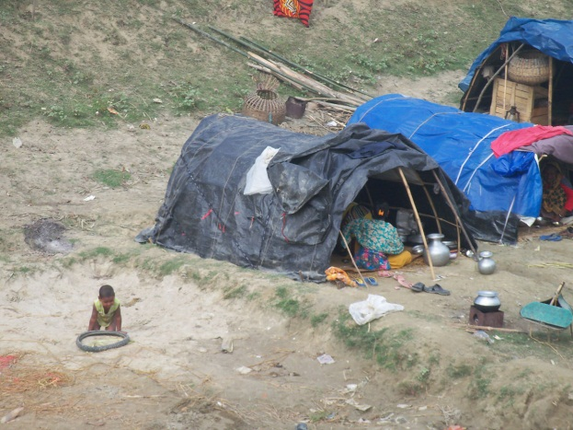
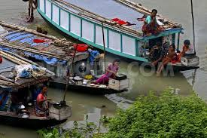
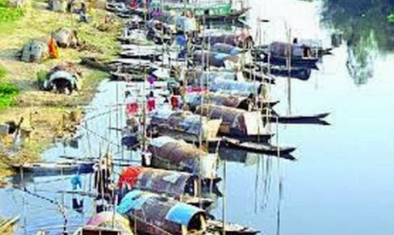
Look at the pictures (4 minutes)
Tant
bedey boats
Row boats

Slide 5
Today’s Lesson is----------
River Gypsies in Bangladesh

Slide 6
Learning out comes
By the end of the lesson Ss will be able to---
Interprete the pictures.
2. Answer the questions.
3. Summarise the passage

Slide 7
Write the new words
New words | শব্দার্থ
Gypsy | যাযাবর
Ethinic | নৃতাত্ত্বিক জনগোষ্ঠী
Roam | লক্ষহীন ভাবে ঘুড়া
Tarpaulin | ত্রিপল/ তেরপাল
Vend | বিক্রয় করা
Heal | আরোগ্য লাভ করা
Talisman | কবজ/ তাবিজ

Slide 8
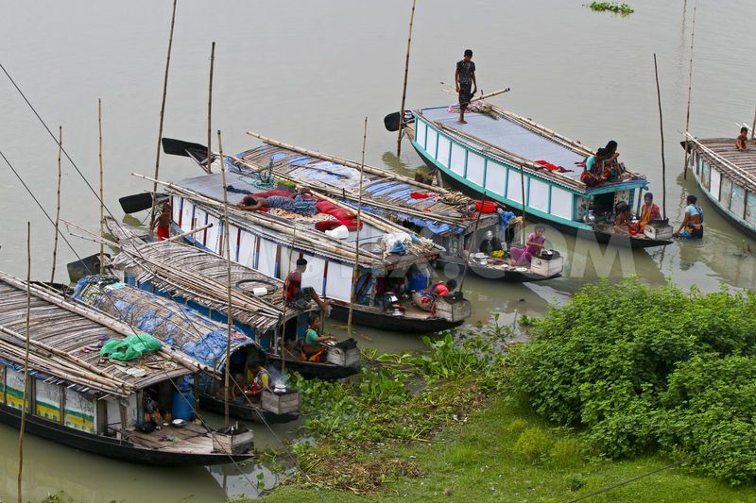
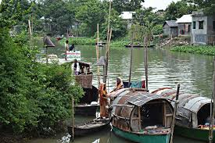
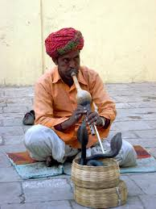
Look at the pictures (4 minutes)

Slide 9
Ss will interprete the picture
Individual work ( 4 minutes)

Slide 10
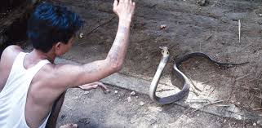
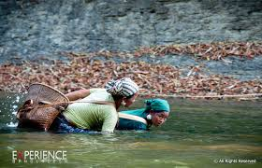
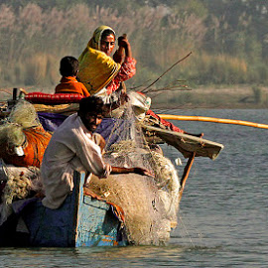
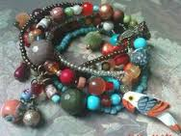
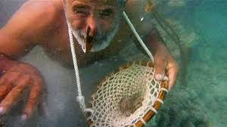
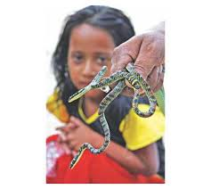
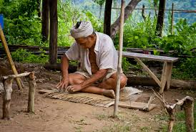
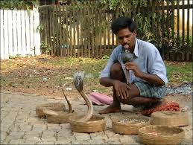
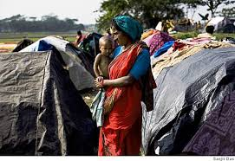
See more pictures

Slide 11
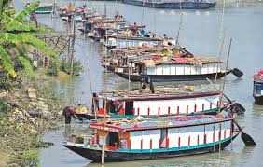
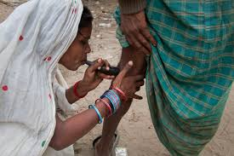
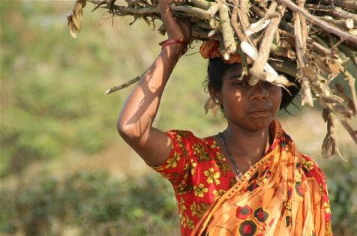
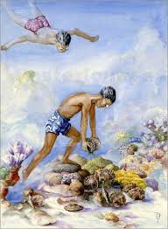
See more pictures

Slide 12
Ss will read the text (8 minutes)

Slide 13
Pair work ( 5minutes)
Ss will answer the questions ( Sec. B)

Slide 14
Ss will read the text “B” again.

Slide 15
Grop work (5 minutes)
Summarise the passage (B)

Slide 16
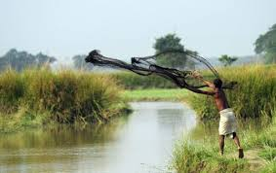
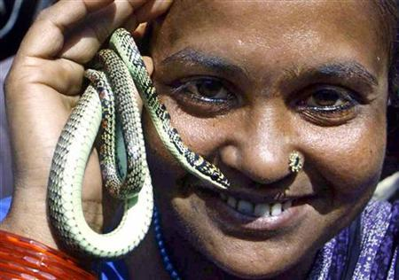
Evaluation
1. What are they?
2. Who are river gypsies ?
3. How do they live?

Slide 17
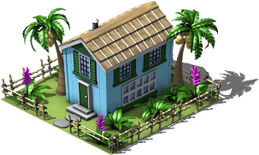
Home Work
1.Write a paragraph on
“River gypsies in Bangladesh.”

Slide 18
Thanks

